Slide 1
Php assignment
Half way assessment

Slide 2
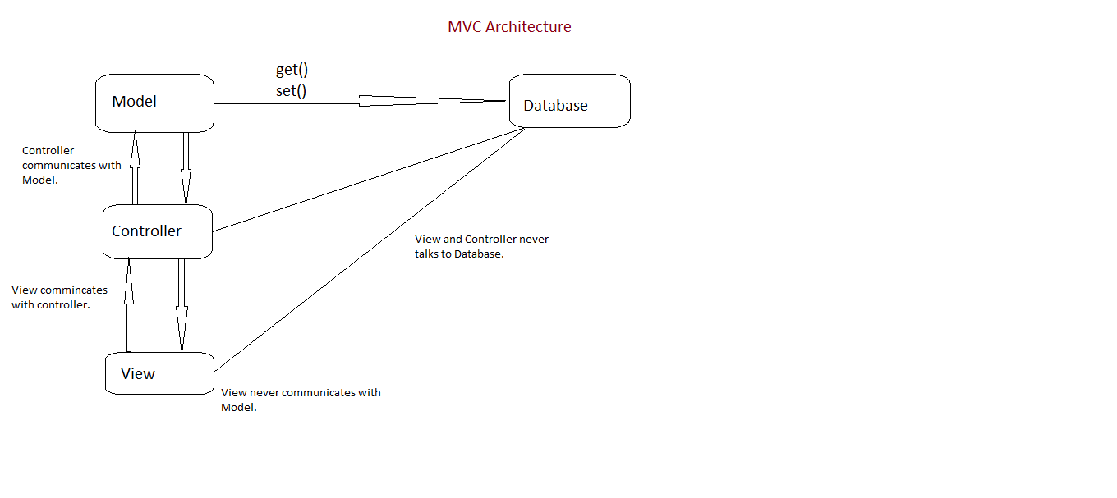
Architecture Design

Slide 3
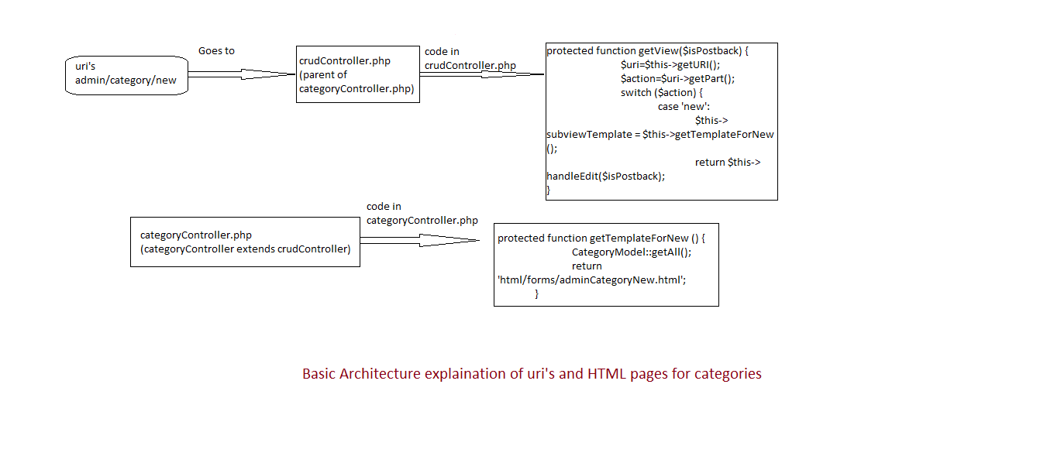

Slide 4
User stories
User A Computer Savvy
Goes on to website and in the search box enters Dell XPS
Finds what he wants clicks for more details
Views larger picture
Adds to the cart
Confirms quantity
He does not have an account
He creates an account

Slide 5
Enter his details into form
Choose a method type
Hits enter
He is congratulated and receives an email confirming purchase
User B
Goes to website clicks on computer category
Goes to printers
Choose a brand then select another for comparison
Decides which one to purchase
Adds to the cart and similar process as user A

Slide 6
User C Returning customer
Logs in
Clicks on a product
Adds to the cart
Selects two more products and adds to the cart
Proceeds to the checkout
Decides to get it delivered
Removes product B
Pay for items
Receives confirmation email

Slide 7
database

Slide 8
Class diagram

Slide 9
framework

Slide 10
Sql injection

Slide 11
Cross site scripting xxs

Slide 12
Cross site request forgery
Sends a request to the user that is passed onto a site that is believed to be logged into
Easiest form of protection is a Token Challenge system
At a token is generated on user log in
Can be done every time a form is loaded
When a form is submitted it has a hidden field containing the token
If the token checks out proceed as normal
Otherwise log the attempt and deny

Slide 13
